Slide 1
University XYZ
Created by
Henry Depew
Franklin Overton
Sami Jenedi
Austin Switzer
Bret Riedel

Slide 2

Databases 101

Slide 3
Databases 101
Tables
Relationships
Primary and Foreign Keys
Queries

Slide 4
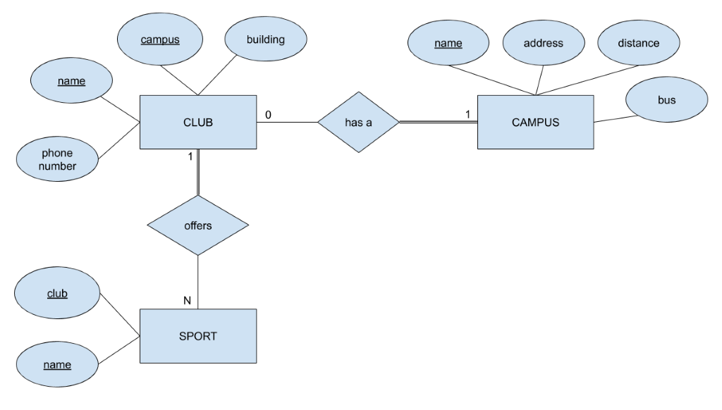
Tables
Entities
Attributes
Relationships

Slide 5
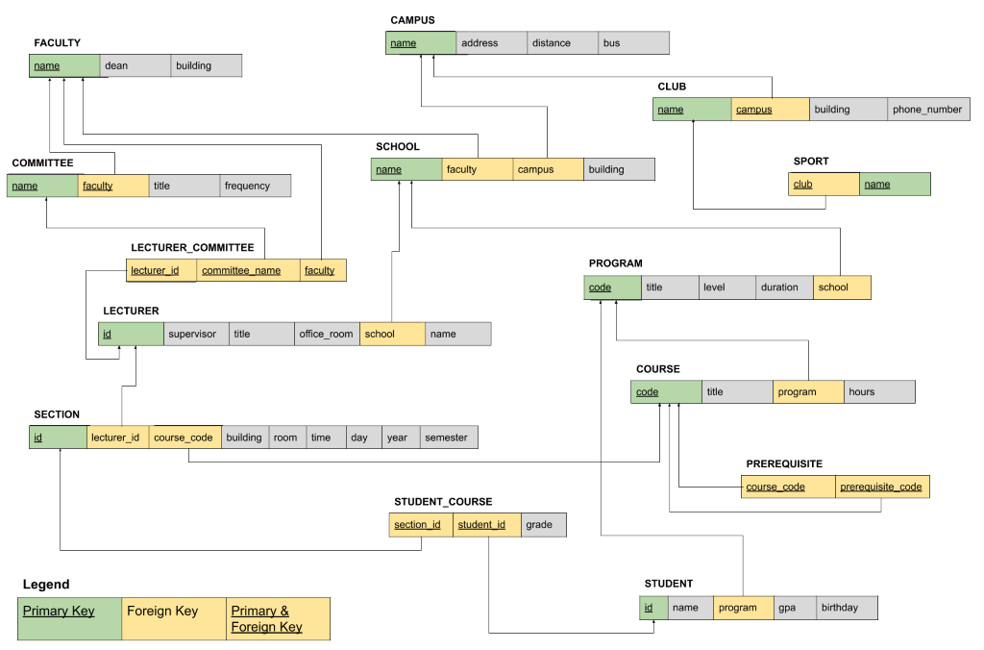
Primary & Foreign Keys
Primary Keys
Must be unique
Foreign Keys
Used to relate between tables

Slide 6
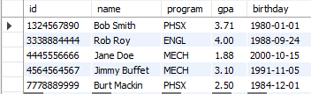
Queries
Structure
SELECT <attribute>
FROM <table>;
Sample Query
SELECT *
FROM STUDENT;

Slide 7

University XYZ

Slide 8
Project Description
The goal of our project was to create a MySQL database for University XYZ. University XYZ needed the database to meet a number of requirements.

Slide 9
Resolving relationships

Slide 10
Resolving Relationships
Our database originally had 10 tables.
These tables contained a number of many-to-many relationships.
By creating intersect entities, we were able to get rid of the many to many relationships in our database.
We now have 14 tables.

Slide 11
Primary and Foreign Keys

Slide 12
DB Hosting
AWS EC2
Other alternatives such as Azure or AWS RDS for more data
Ubuntu 18.04
Free Linux offering in EC2
MySQL 5.7
Accessed with MySQL Workbench

Slide 13

Demo

Slide 14

Query 1
Franklin
List all the schools located on ‘Toronto Campus’, and sort them by school name.
SELECT name as “School Name”
FROM SCHOOL
WHERE campus LIKE ‘%Toronto% ‘
ORDER BY name;

Slide 15

Query 2
Bret
List all the programs provided by ‘science faculty’.
SELECT p.title as “Program Title”
FROM PROGRAM p
INNER JOIN SCHOOL s
ON p.school = s.name
WHERE s.faculty LIKE ‘Science’;

Slide 16

Query 3
Franklin
Give all the names of the lecturers who are the members of the committee and sort by their name.
SELECT name as Member
FROM LECTURER l
INNER JOIN LECTURER_COMMITTEE lc
ON l.id = lc.lecturer_id
WHERE lc.committee_name LIKE ‘Advisory’ && lc.faculty LIKE ‘Science’
ORDER BY l.name;

Slide 17

Query 4
Austin
List all supervisor’s names and the names of the lecturers they manage. Please sort by supervisor name and lecturer name.
SELECT t1.name as Supervisor, t2.name as Subordinate
FROM LECTURER t1
JOIN LECTURER t2
ON t1.id = t2.supervisor;

Slide 18
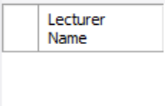
Query 5
Austin
Give all the lecturers who are not members of a committee.
SELECT name as “Lecturer Name”
FROM LECTURER t1
LEFT JOIN LECTURER_COMMITTEE t2
ON t1.id = t2.lecturer_id
WHERE t2.lecturer_id IS NULL;

Slide 19
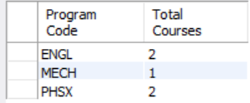
Query 6
Sami
Give the total number of courses for each program.
SELECT program as “Program Code”, COUNT(code) as “Total Courses”
FROM COURSE
GROUP BY program;

Slide 20
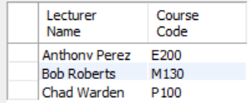
Query 7
Sami
Give all the lecturers with the courses they are teaching. Sort by lecturer name.
SELECT name as “Lecturer Name”, s.course_code as “Course Code”
FROM LECTURER l
INNER JOIN SECTION s
On l.id = s.lecturer_id
WHERE l.id = s.lecturer_id
ORDER BY l.name;

Slide 21
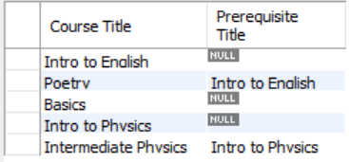
Query 8
Henry
Give all the course titles and their corresponding prerequisite course titles.
SELECT c.title as “Course Title”, c2.title as “Prerequisite Title”
FROM COURSE c
LEFT JOIN PREREQUISITE pr
ON c.code = pr.course_code
LEFT JOIN COURSE c2
ON pr.prerequisite_code = c2.code;

Slide 22
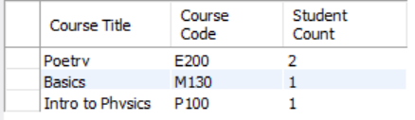
Query 9
Bret
Give the top 5 courses which have the most students.
SELECT c. title as “Course Title”, s.course_code as “Course Code”, COUNT(sc.section_id) as “Student Count”
FROM SECTION s
INNER JOIN STUDENT_COURSE sc
ON s.id = sc.section_id
INNER JOIN COURSE c
ON c.code = s.course_code
GROUP BY s.course_code
ORDER BY COUNT(sc.section_id) DESC
LIMIT 5;

Slide 23
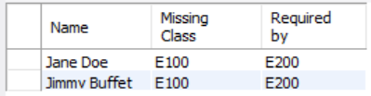
Query 10
Henry
Give any students and the Prerequisites they need to take based on classes they are enrolled in currently.
SELECT s.name as Name, pr.prerequisite_code as ‘Missing Class’, pr.course_code as ‘Required by’
FROM STUDENT s
INNER JOIN STUDENT_COURSE sc
ON s.id = sc.student_id
INNER JOIN SECTION sn
ON sn.id = sc.section_id
INNER JOIN PREREQUISITE pr
ON sn.course_code = pr.course_code
WHERE (s.id, pr.prerequisite_code) NOT IN
(SELECT sc.student_id, sn.course_code FROM SECTION sn
INNER JOIN STUDENT_COURSE sc
ON sc.section_id = sn.id);

Slide 24

Closing Thoughts

Slide 25
Experiences
Unique experience
Creating database
Inner workings
MYSQL Workbench
Cloud hosting
Planning
Designing

Slide 26
Creating A Database from Scratch And Working With The Database
Wasn’t easy
Not one size
Routine
Planning
Quite a bit that needs to be done

Slide 27
What Would We Do If We Had To Do It Again?
Create database
Relationships
Spend more time
Find a better tool
Ask better questions

